Slide 1
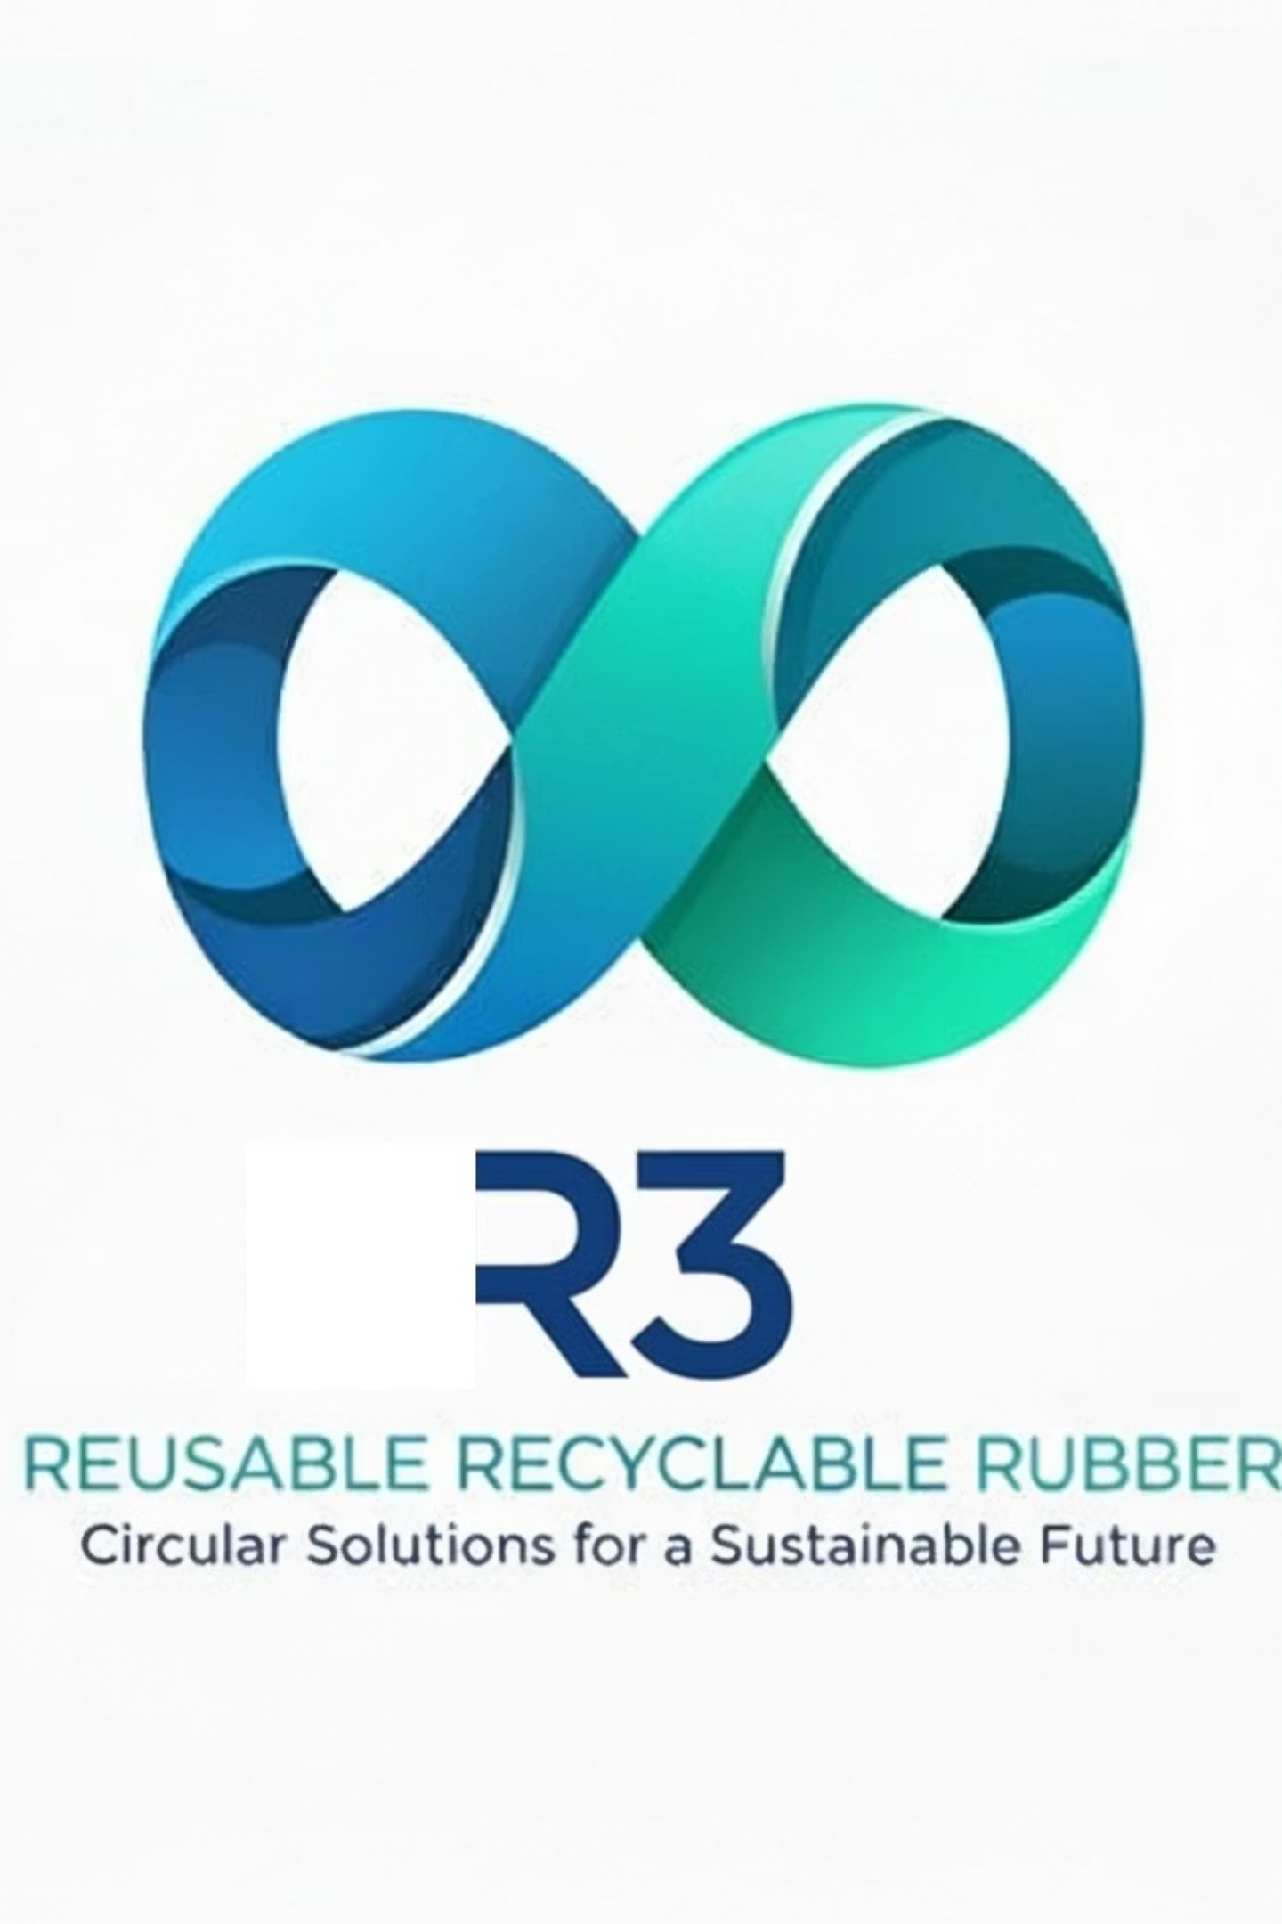
R3 Dunnage
Reusable Recyclable Rubber

Slide 2
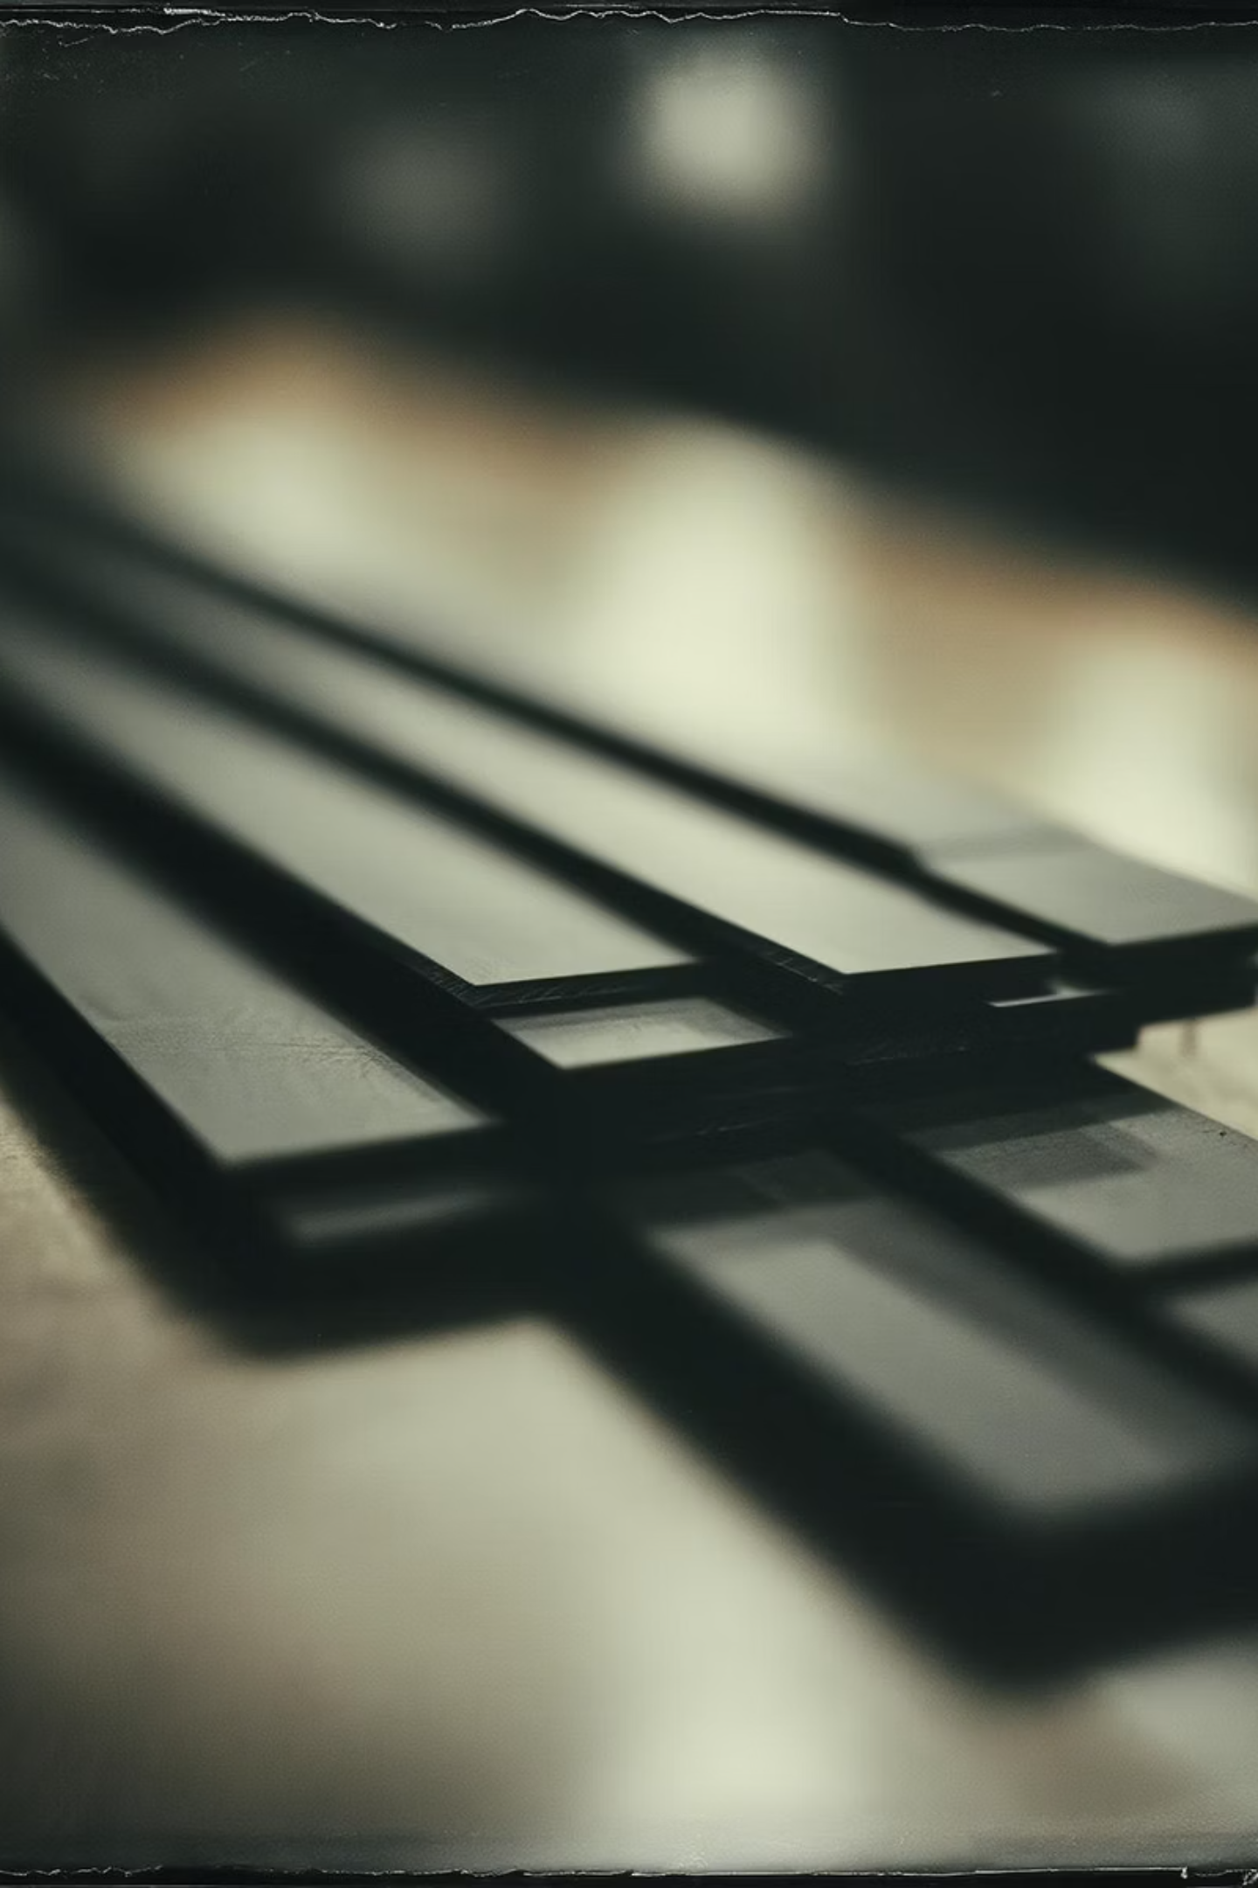

Introducing R3 Dunnage: The Smarter Alternative
R3
Reusable • Recyclable • Rubber
R3 Dunnage represents a breakthrough in cargo securing technology, high performance and sustainable dunnage solution crafted from a proprietary, engineered rubber compound. Our blocks are precision-manufactured to outperform traditional wood and composite alternatives .
Designed with input from logistics and maritime professionals, R3 Dunnage addresses the challenges you face daily.
Our Promise: Superior cargo stability with a reduced environmental footprint, backed by measurable data and a commitment to your success.

Slide 3
Unmatched Performance & Safety
Engineered to Carry More with Less
Superior Safe Working Load
Exceptional Compression Resilience
Superior Coefficient of Friction
309
Grips cargo like rubber, because it is rubber. Unlike wood or plastic alternatives, R3 Dunnage creates exceptional surface contact and resistance to lateral movement.
10%
Metric Tons (R3 Dunnage)
vs. 139 Metric Tons (Hardwood)
Maximum Compression Loss
More than double the strength of equivalent sized hardwood blocks, enabling you to secure heavier loads with greater confidence and fewer support points.
With almost full recovery after load removal. Wood compresses permanently with no recovery, composites can crack under extreme pressure. R3 bounces back and is ready for the next load.
Result: Fewer pieces needed to achieve the same stability, simplifying logistics operations and enhancing safety.

Slide 4
Operational & Economic Advantages
Do More with Less, Safely and Efficiently
Optimized Quantity
Easy & Safe Handling
Higher strength and superior friction per unit translate directly into fewer blocks required per shipment. This reduction creates cascading benefits: simplified load planning, reduced material handling time, and lower overall dunnage inventory requirements across your fleet.
Each block weighs 3.75 kg. Though heavier than wood, it is designed with D shaped handling inset to reduces worker strain and injury risk during operations. No splinters or awkward grip points.
Reusable Design
Environment Friendly
Based on current tests—static and dynamic during the first ocean crossing—R3 has shown durability for 8–10 uses. We believe future studies will confirm even greater reuse potential. To demonstrate commitment, Grabkit will rent the initial shipment for 4 sea crossings, after which we’ll reassess with clearer performance data and discuss long‑term deployment.
Made from natural materials, our dunnage is both recyclable and reusable, supporting sustainable logistics practices and reducing environmental footprint.

Slide 5
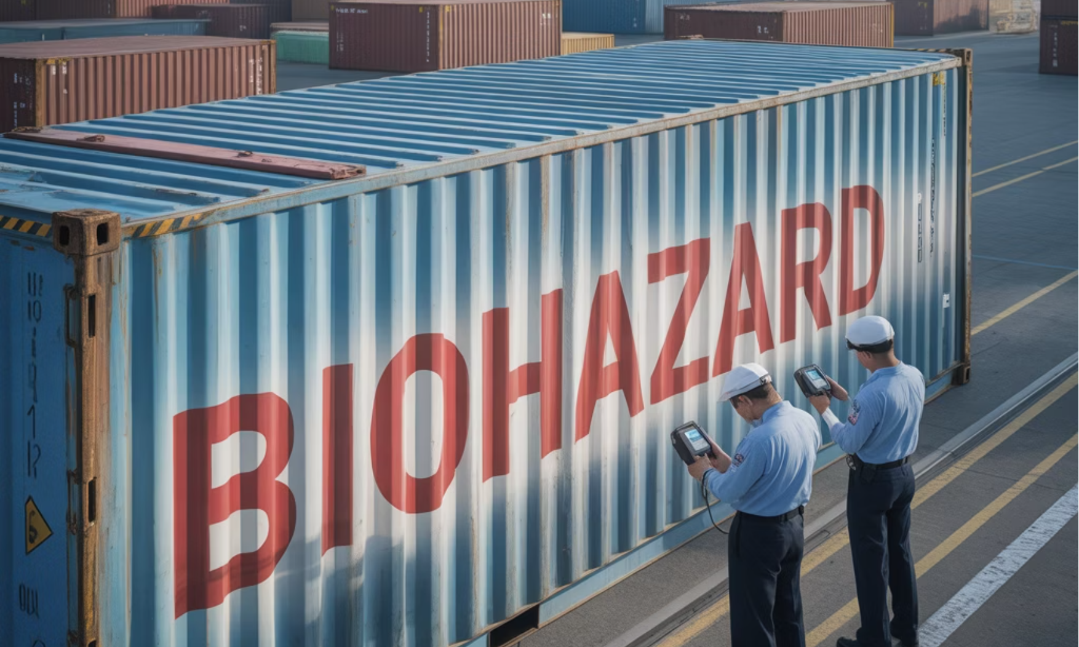
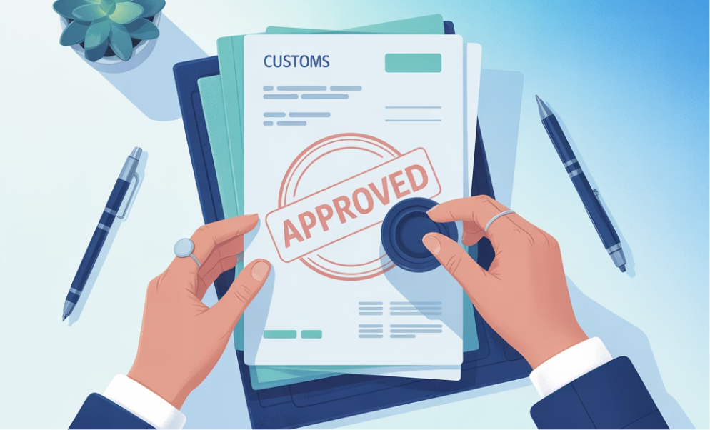
Simplifying Global Compliance
Ship with Confidence, Anywhere.
International shipping compliance can be a minefield of regulations, certifications, and potential delays. R3 Dunnage eliminates major trade barriers that plague traditional wooden dunnage, giving you peace of mind and smoother operations across all global markets.
✓ No Phytosanitary Certification Required
Our engineered rubber material is inherently pest-free and non-organic, eliminating the need for ISPM 15 heat treatment certifications, documentation, and the associated costs and delays.
Result: This ensures faster customs clearance in all major markets, including Canada, USA, Europe, Australia, New Zealand, and Asia-Pacific regions.
✓ Zero Biosecurity Risk
R3 Dunnage eliminates the threat of invasive species like the Asian Gypsy Moth (AGM), Emerald Ash Borer, and other wood-boring pests.
Result: This prevents costly cargo rejections, quarantine delays, mandatory fumigation expenses, and fines at international ports of entry.
Compliance Advantage: By switching to R3 Dunnage, you're not just meeting regulations, you're eliminating an entire category of regulatory risk from your supply chain. This translates into faster transit times, reduced administrative burden, and improved delivery reliability.

Slide 6






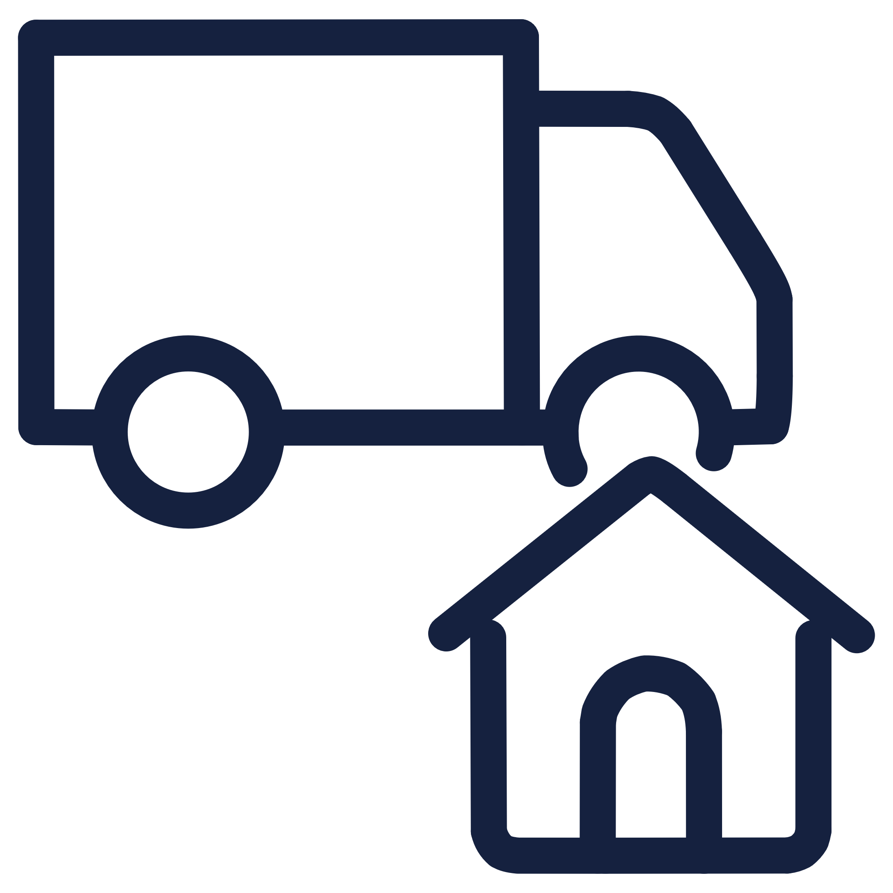

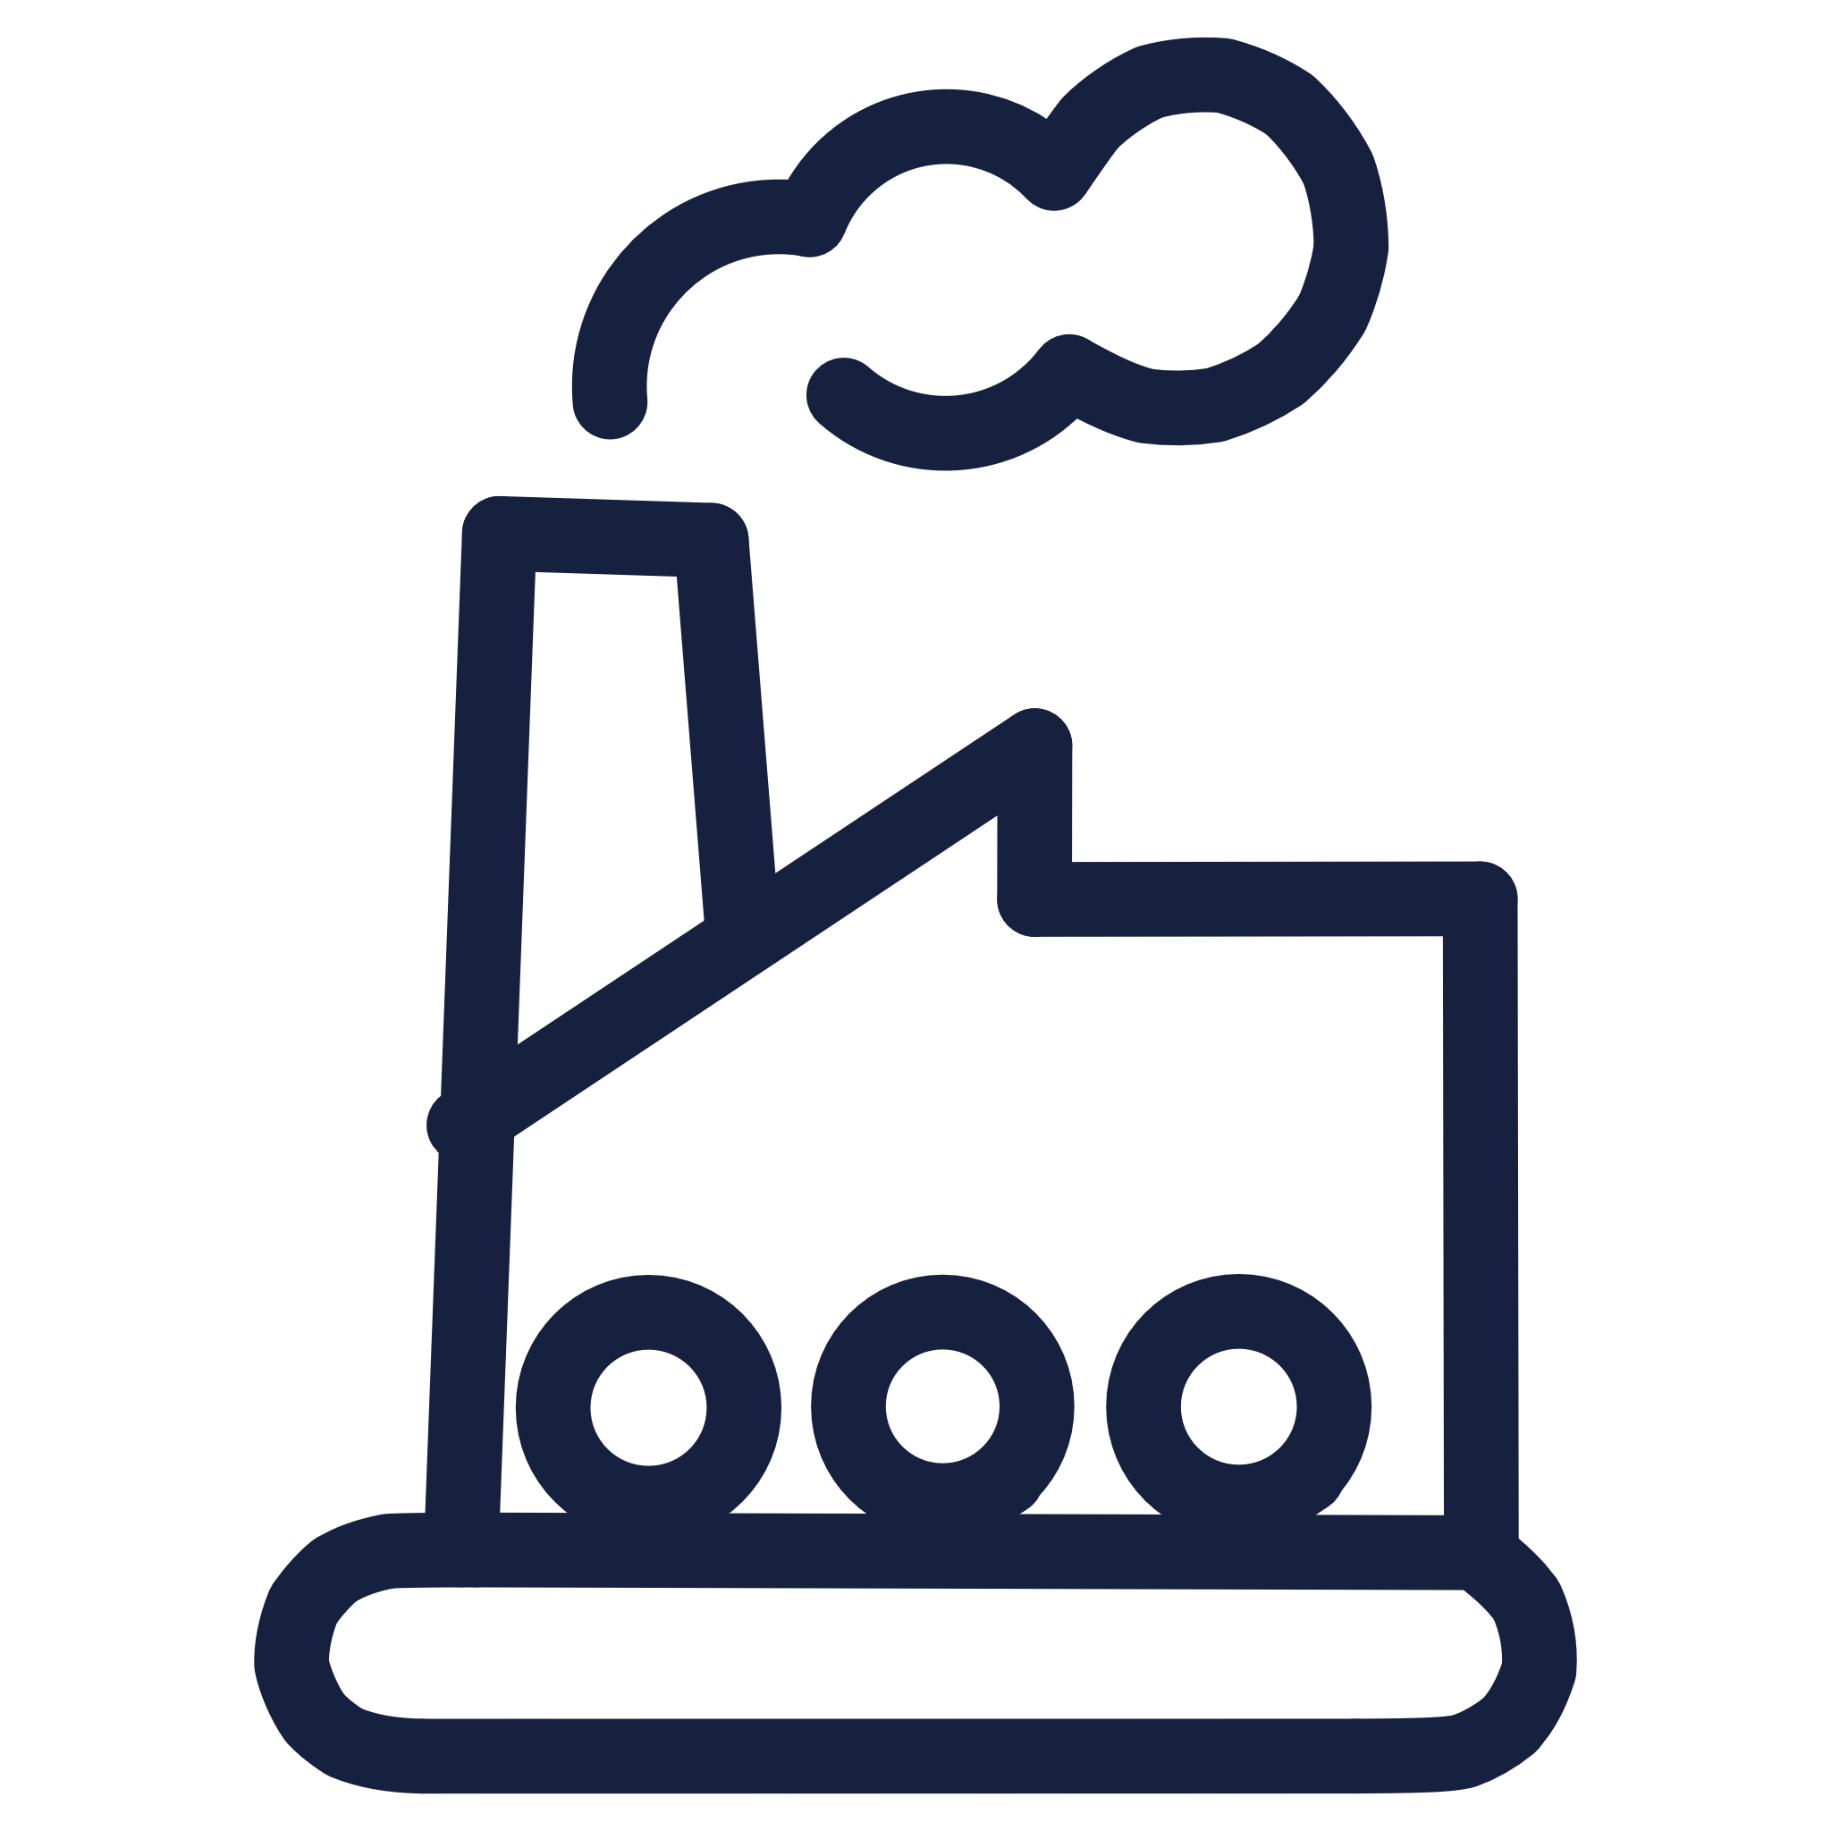

The R3 Lifecycle: A Closed-Loop Model
Beyond Recyclable: We Close the Loop
While other dunnage solutions end up in landfills or uncertain recycling streams with questionable environmental outcomes, R3 Dunnage is part of a verifiable, transparent circular economy.
Performance Monitoring
Active Service
Blocks are periodically inspected for wear and degradation. Our inspection guidelines help you identify when a block should be retired from active service.
R3 Dunnage blocks are deployed across your shipping operations, providing superior cargo stability higher number of shipping cycles depending on load conditions and handling practices.
End of Life Return
When blocks finally reach the end of their service life, they're returned through our collection network at a simple and cost-effective manner.
Sustainable Rubber Remanufacturing
Processed material is re-compounded into new recyclable rubber products, closing the loop on sustainability.
Material Processing
Returned blocks are ground down and the rubber compound processed, maintaining material quality standards through our proprietary recycling methodology.

Slide 7
The Challenge with Traditional Dunnage
Inefficient, Inconsistent, and Risky. The global supply chain relies on dunnage for cargo safety, but traditional options present significant drawbacks that create operational inefficiencies, increase costs, and introduce unnecessary risks to your supply chain.
Wooden Dunnage
Composite/Plastic Dunnage
Inconsistent Quality: Strength and friction vary by wood species, moisture content, and the presence of knots or defects
Low Friction: Often slippery under load, requiring more pieces and complex bracing systems
Biosecurity Risk: Harbors invasive pests like the Asian Gypsy Moth, requiring costly ISPM 15 certification and heat treatments
Sustainability: Primarily manufactured from virgin plastic, recycling streams are complex and not always available
Single Use : Discarded after one trip, creating substantial waste streams and disposal costs
Deformation: crack, warp, or deform under heavy or uneven loads, permanently losing structural effectiveness
Heavy & Hazardous: Difficult and unsafe for workers to handle
Variable Performance: Quality and strength can vary significantly between manufacturers and product lines

Slide 8
Competitive Landscape Overview
Understanding how R3 Dunnage compares to traditional alternatives across critical performance and operational metrics helps illustrate the comprehensive advantages of making the switch. This comparison is based on standardized testing and real-world operational data.
R3 Dunnage (Rubber)
Wooden Dunnage
Composite/Plastic Dunnage
Strengths: Superior across virtually all metrics, particularly in load capacity, friction, and closed-loop sustainability
Strengths: Low initial cost, universal availability
Strengths: Lightweight, no biosecurity issues, reusable
Weaknesses: Inconsistent performance, compliance challenges, single-use disposal, biosecurity risks
Weaknesses: Low friction, questionable recycling, deformation
Consideration: Higher initial investment offset by reusability and performance

Slide 9
Summary of Pros and Cons
Every dunnage solution involves trade offs. We believe in transparency about both the substantial advantages and the considerations involved in switching to R3 Dunnage.
R3 Dunnage Advantages
Considerations
Safety & Performance Leadership
Higher Initial Investment
More than 2 x the Safe Working Load of hardwood, superior friction characteristics preventing cargo shift, and exceptional compression resilience with full recovery.
While the capital cost per block is higher than single-use wooden alternatives, rapid ROI is achieved through reusability—typically within four uses—further enhanced by requiring fewer pieces overall.
Operational Efficiency Gains
Fewer pieces needed per load, easier handling reduce loading time, minimize worker fatigue.
System Management
Measurable Cost Reduction
Maximizing value requires a tracking and return system for reuse. We can implement support, best practices, and can integrate with existing systems.
Eliminates disposal fees, removes ISPM 15 certification costs, and lowers per-shipment dunnage expenses through extensive reusability—delivering ROI in as few as four uses.
Compliance & Risk Elimination
Market Maturity
Zero biosecurity risk eliminates the threat of cargo rejections and quarantine delays; seamless border clearance in all major markets without phytosanitary documentation requirements.
As a newer solution compared to century old wood practices, some supply chain partners may need education. We provide technical documentation and support for customer conversations.
Genuine Sustainability
Extensively reusable across 8-10 of shipping cycles, We believe future studies will confirm even greater reuse potential, and when retired, each block is returned through our verified closed-loop recycling program – delivering true operational circular economy.
Perfect Consistency
Engineered manufacturing ensures every block delivers identical, predictable performance no variation by moisture content, no knots, no defects. Simplifies load planning and eliminates performance uncertainty.

Slide 10








The Wooden Dunnage Challenge
Resource & Production Impact
Disposal Complications
Wooden dunnage relies on finite timber resources and energy-intensive production, generating significant, unrecoverable wood waste from manufacturing through usage.
Contamination and chemical treatments prevent recycling, leading to all wooden dunnage being landfilled or incinerated after a single use.
Logistical Inefficiencies
Compliance & Risk
Wooden dunnage increases transport costs and carbon emissions. Its inconsistent quality often leads to product damage during shipping.
ISPM 15 treatment is mandatory for international shipments, while moisture absorption risks mold, odor, and compromised product integrity and cargo safety.
ISPM 15 Fumigation: A Critical Compliance Burden
Incineration's Hidden Toll: Toxic Emissions and Residues
Environmental Impact: Methyl Bromide, an ozone-depleting substance, causes significant environmental damage and is heavily regulated.
Annually, an estimated 30,000 cubic meters of fumigated wood are incinerated in from just 2 terminal in Vancouver BC.
Operational Costs: Fumigation adds considerable costs (treatment, certification, documentation) and time to shipments. Improper certification risks cargo rejection, delays, or destruction.
This process has severe environmental consequences:
Toxic Emissions: Incinerating fumigated wood releases hazardous gases, including formaldehyde, benzene, and dioxins, which are known carcinogens and respiratory irritants.
Health Risks: Methyl Bromide poses serious nervous system and respiratory risks to workers if safety protocols are not rigorously followed.
Hazardous Residue: The residual ash contains toxic compounds and heavy metals, posing long-term health and environmental risks if not properly contained and treated.

Slide 11



The Future of Dunnage is Here
Ready to Make the Smarter Switch?
The logistics and supply chain industry is evolving rapidly. Sustainability mandates are tightening, labor costs are rising, and operational efficiency has never been more critical to competitive advantage. R3 Dunnage represents the convergence of these trends a solution that simultaneously addresses performance, safety, compliance, cost, and environmental responsibility.
Our Story: Born from Maritime Expertise
The Solutions
Research & Development
After years of research and development and rigorous testing, R3 Dunnage was created, meeting every goal we set when the product was just a concept.
Visionary Collaboration
The R3 journey began in 2009 when the concept was first envisioned. Through extensive testing of various materials and prototypes, we discovered that none of the initial products met all our requirements. The project was temporarily paused.
Our journey began when a group of Master Mariners came together with a question:
Our first sea trial proved that the years of effort were worthwhile and the product matched our vision.
How can we disrupt the industry? What can we do differently to make a real change?
The answer: reimagine dunnage as eco-friendly, sustainable, and reusable.
After 2020, we reignited the R&D effort. After rigorous testing of multiple prototypes, we finally achieved our breakthrough: "R3 Dunnage" was created.

Slide 12
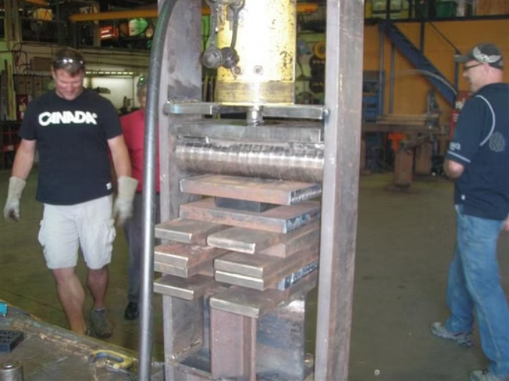
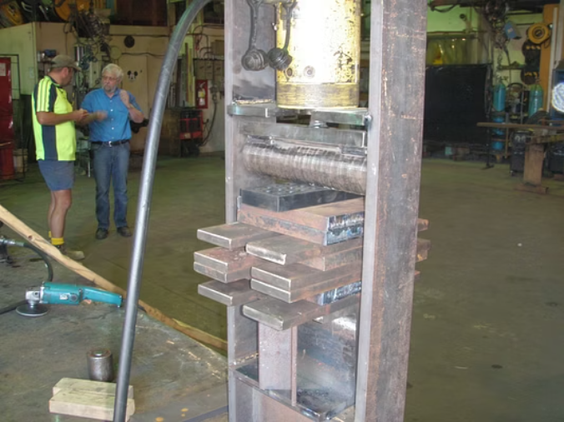
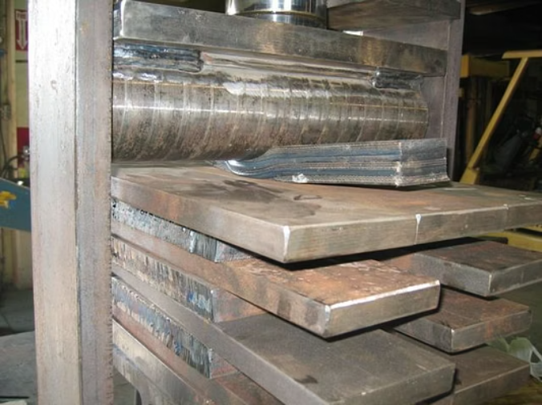
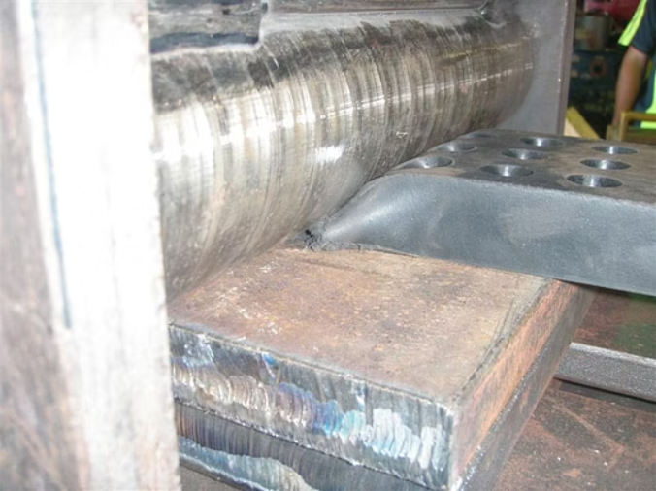
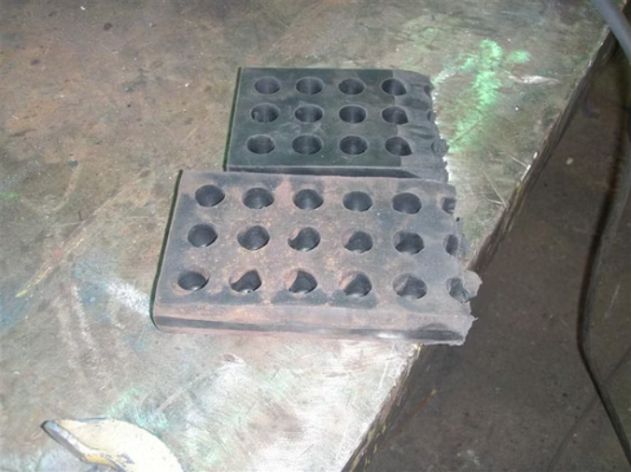
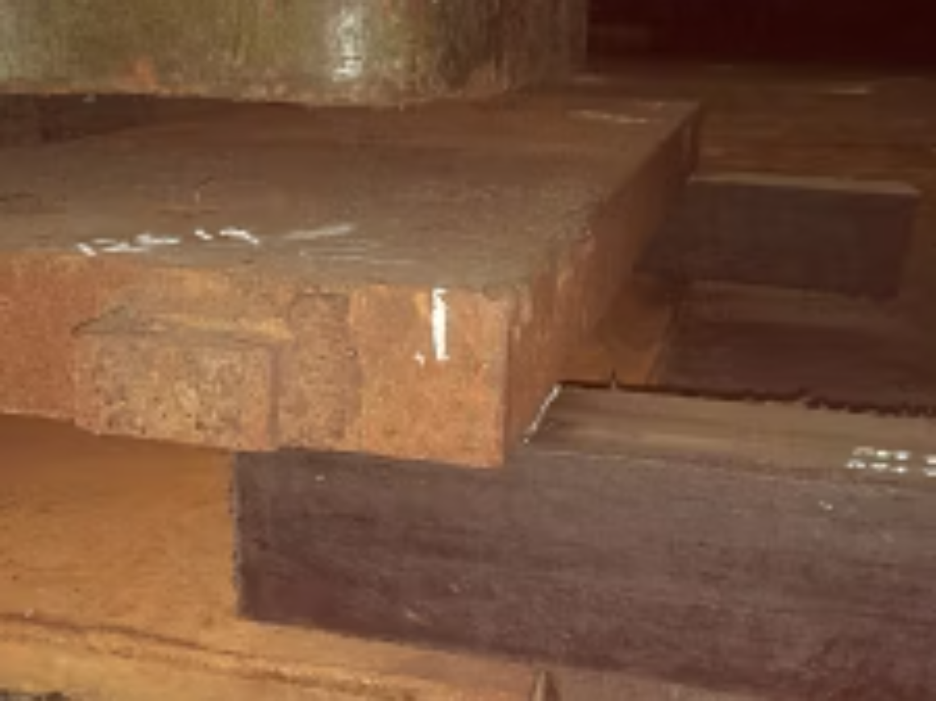
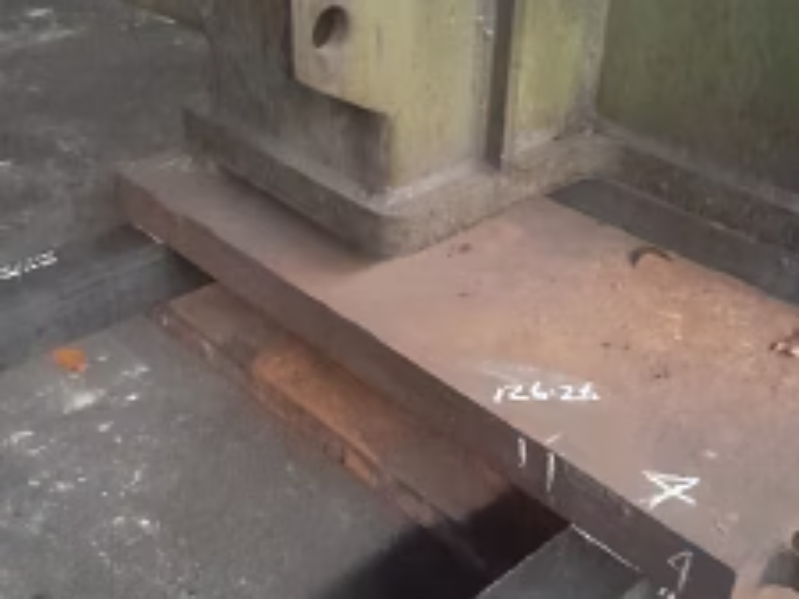
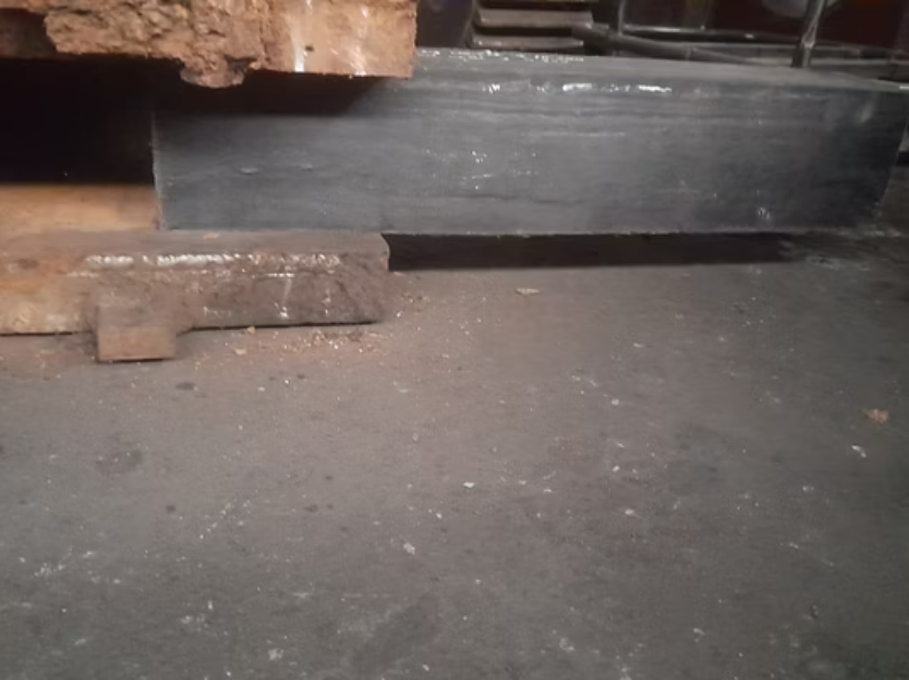
Rigorous Testing & Iterative Refinement
R3 Dunnage development began in 2009, advancing through multiple prototype cycles that were meticulously designed, tested, and refined to overcome identified shortcomings. A comprehensive regression testing program safeguarded performance and reliability throughout each iteration. Among the critical evaluations, a two-month static load test validated durability and consistency under real-world operational conditions. The accompanying images document this journey, capturing the evolution from early prototypes to progressively improved designs.
Two-month static load test –no deformation, 100% recovery

Slide 13
R3 Dunnage Performance: Data from Sea Trials
Don't just take our word for it—review the Sea Trial Data.
The R3 Dunnage solution was rigorously tested during a winter ocean crossing (February – March 2025).
The trial was successfully completed under challenging conditions, encountering rough seas up to Force 9.
Sea Trial Summary
Rigorous testing occurred during the Feb–Mar 2025 ocean crossing.
The trial encountered rough seas up to Force 9, providing extreme testing conditions.
Sizes tested:
  24” × 5’’× 4” – 20 pcs
  24” × 5’’ × 2” – 20 pcs
  24” × 5’’ × 1” – 20 pcs
  Total: 60 pcs
Load Compression: 6–10%, with 100% rebound upon release.
Post-voyage status: No damage observed; dimensions stable for guaranteed reuse.
Integration: Plate grabs fitted easily on steel plates.
Key Outcomes and Operational Benefits
Trial Conclusion: Sea trials were successful, validating R3 Dunnage for immediate operational use.
Sustainability: Reusable and recyclable, leading to reduced wood waste and a lower CO₂ footprint.
Compliance: Eliminates the risk of invasive species contamination (ensuring ISPM 15 compliance).
Performance: Achieves a higher Safe Working Load (SWL) and provides superior cargo friction compared to traditional wood dunnage.

Slide 14
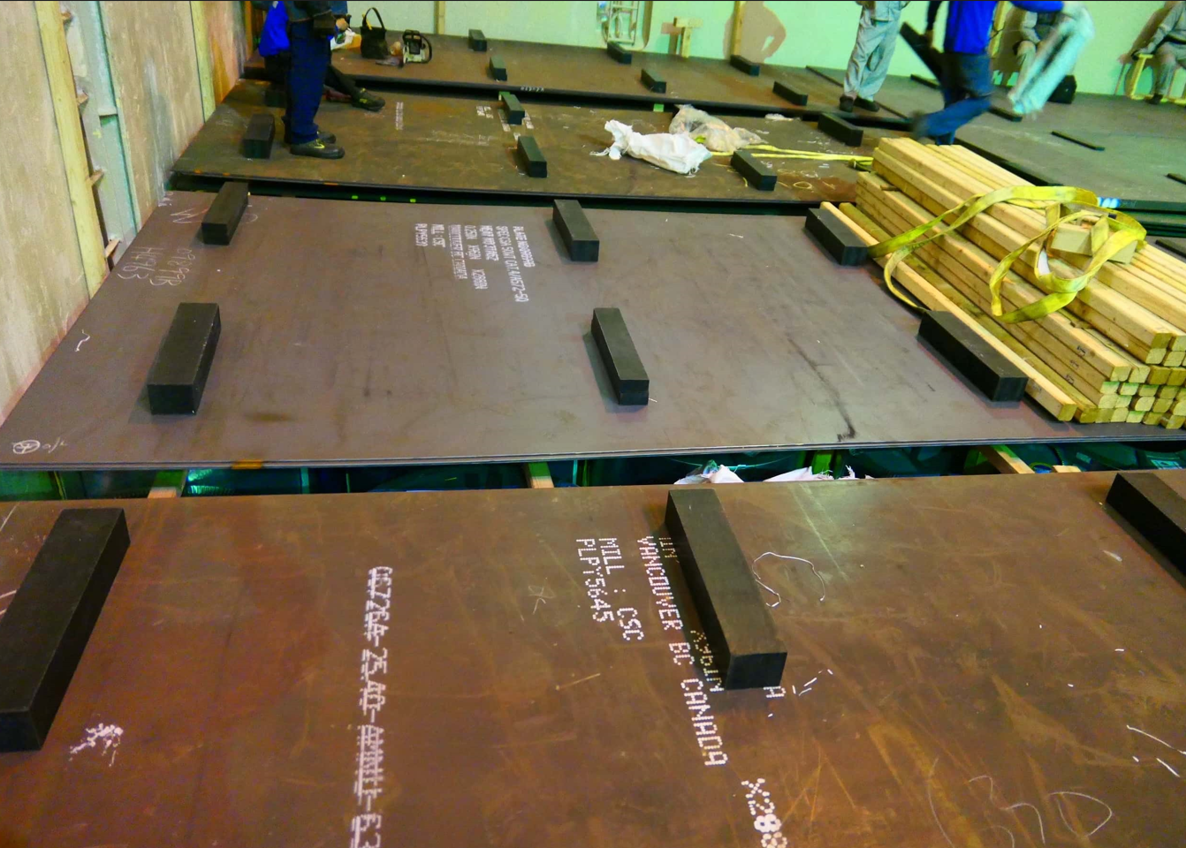
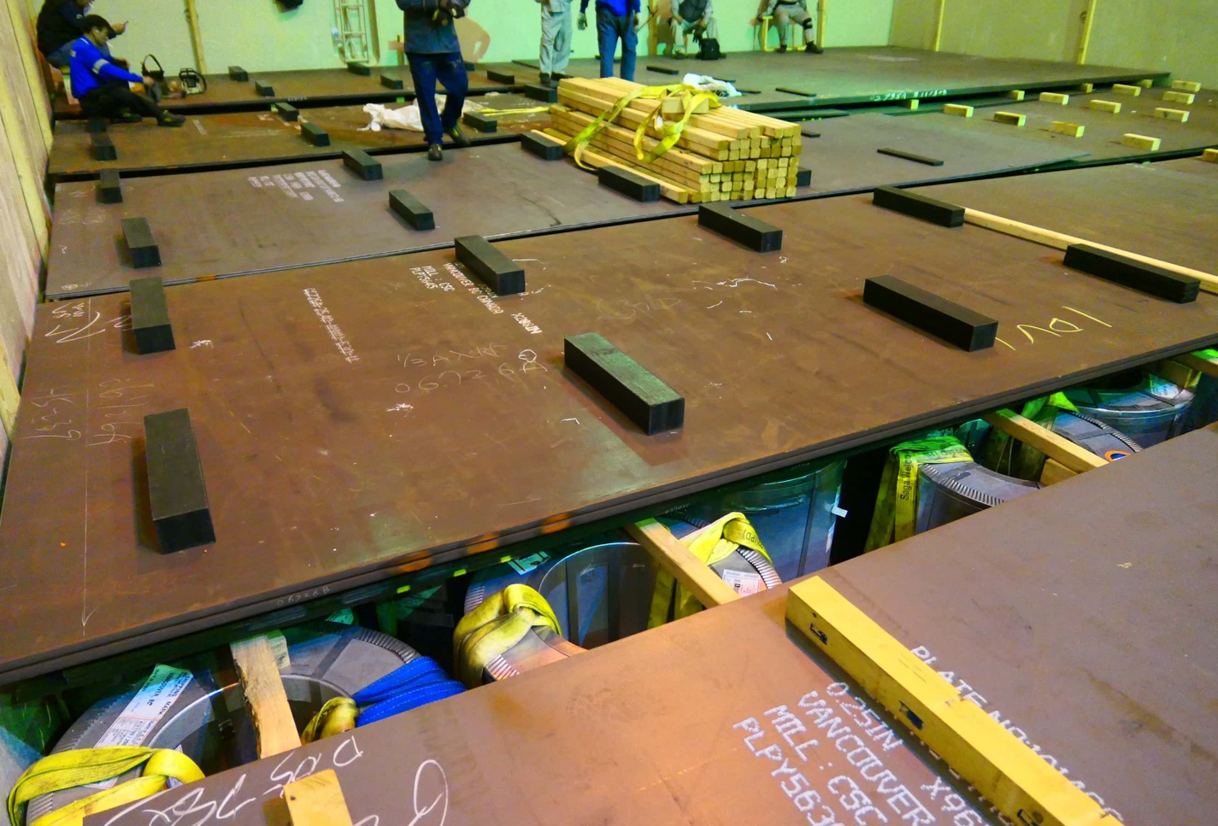
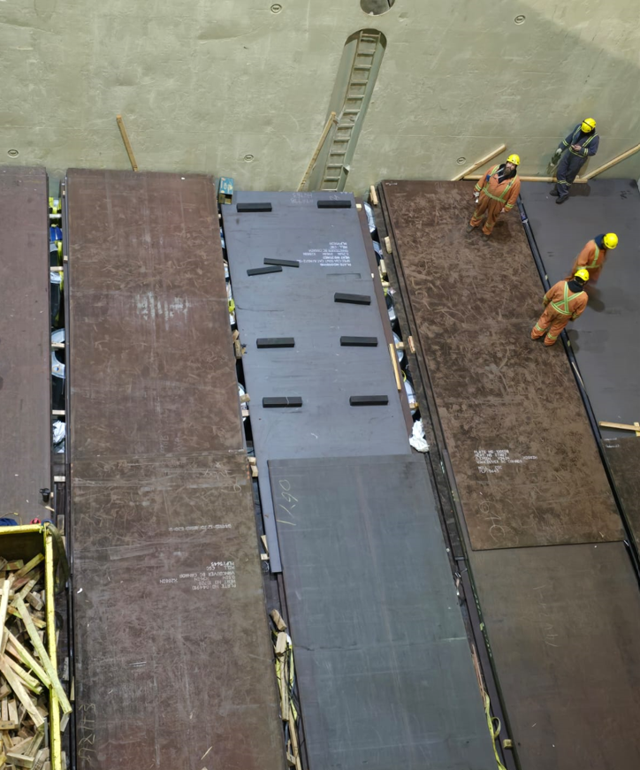
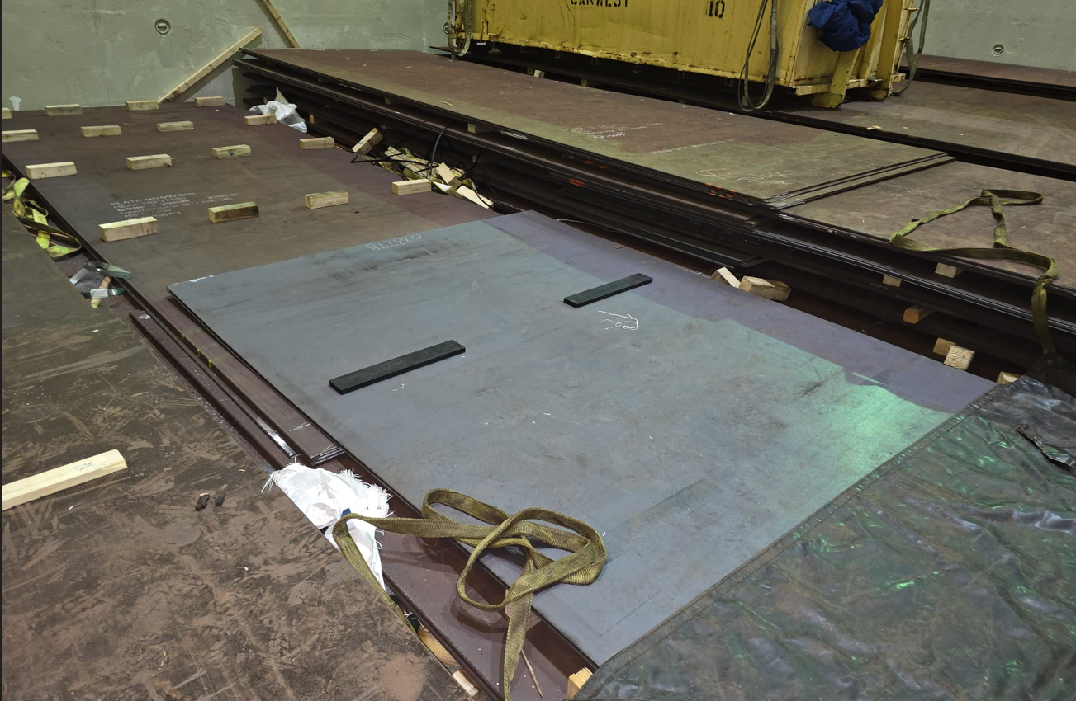
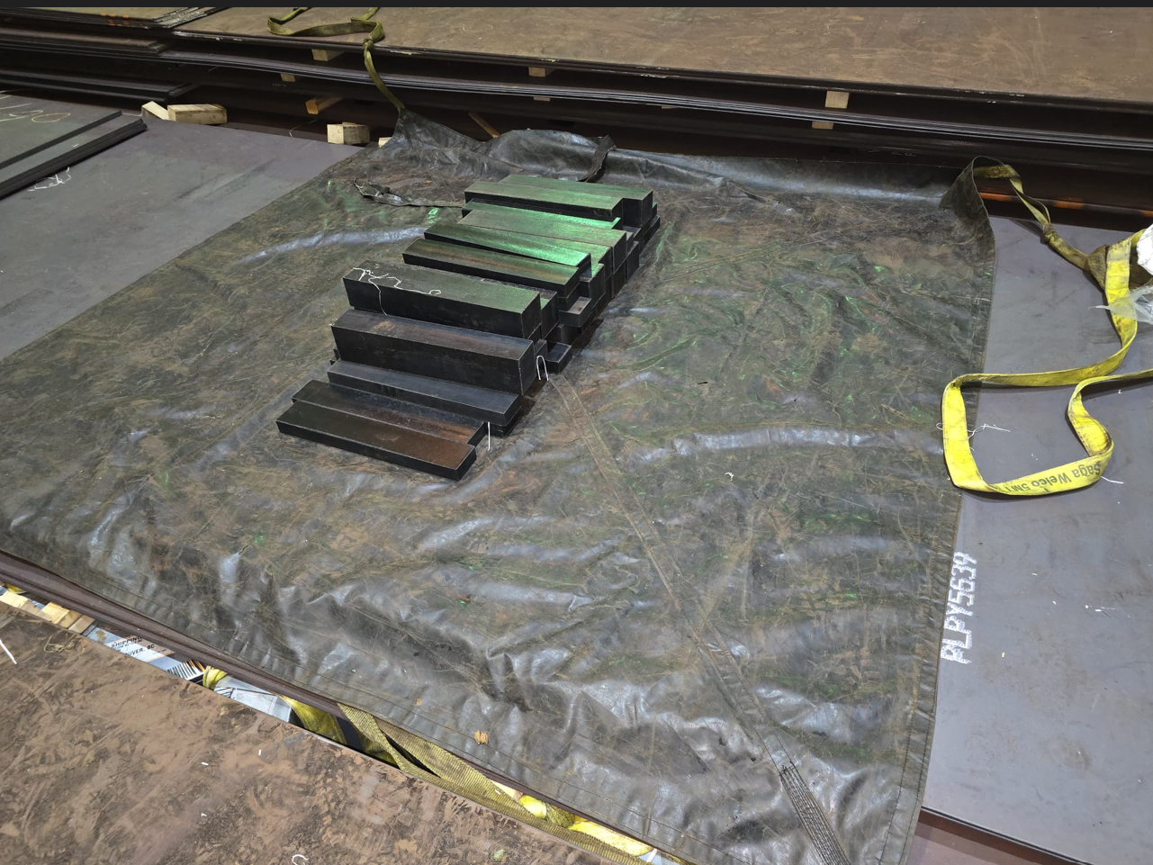
Visual Evidence: R3 Dunnage in Use
Photos at load port
Photos at discharge port after use

Slide 15
Next Steps: Partner with R3 Dunnage
We understand that changing dunnage systems is a significant decision that impacts multiple aspects of your operations. That's why we've designed a straightforward, risk managed pathway to help you evaluate R3 Dunnage and experience the performance difference first-hand.
01
02
03
Arrange a Live Demonstration
Request a Pilot Program
Receive Detailed ROI Analysis
See the performance difference, we can send you all the details of the tests carried out, Including test results to ensure all the parameters mentioned are in order.
Test R3 Dunnage in your actual operations with real loads and shipping conditions. We'll work with you to design a pilot program that provides meaningful performance data while minimizing operational disruption.
Based on shipping volumes, routes, and current dunnage costs, a comprehensive financial model showing projected savings, payback period, and long-term cost benefits. This analysis includes disposal cost elimination, reduced material usage, and compliance simplification.
Technical Support
Ongoing Partnership
Our team provides comprehensive technical documentation, load calculation assistance, and implementation guidance to ensure successful integration into your operations.
Your success is our success. We provide continuous support, performance monitoring, and optimization recommendations as your program matures and scales.
Contact Us Today to Revolutionize Your Cargo Securing
Don't let outdated solutions hold your supply chain back. Reach out to discuss how R3 Dunnage can transform your cargo securing operations, reduce costs, and advance your sustainability goals.

Slide 16
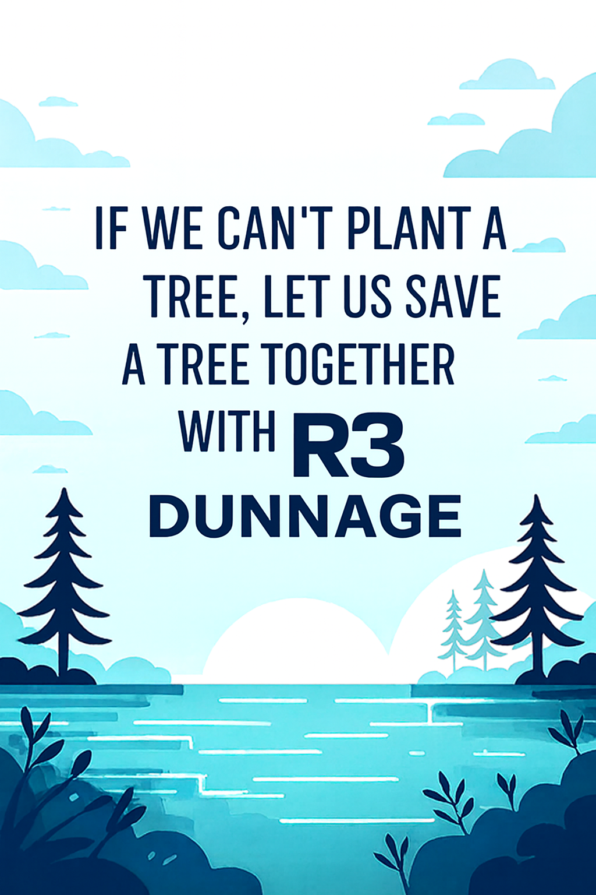

Ready to Experience the R3 Advantage?
We appreciate your time and consideration. R3 Dunnage is more than a product, it's a commitment to operational excellence, worker safety, and environmental responsibility in global logistics.
Our team is ready to answer your questions, provide detailed technical specifications, and begin the conversation about how R3 Dunnage can deliver measurable value to your organization.
Let's Build Something Better Together. Contact our sales team to schedule your demonstration or pilot program, and take the first step toward smarter, safer, more sustainable cargo securing.
Partnering for meaningful change
Thomas Karimpanal
Mobile:
+1 778-879-4909
Email:
info@grabkitsolutions.com
Address:
2996 Dolphin Drive, Nanoose, BC, V9P 9J3, Canada

